Slide 1

CSA15 | Cloud Computing and Big Data Analytics
CSA15 Cloud Computing and Big Data Analytics
Presenter Details
Student Name: VISWANATH SAI SANDEEP
Register Number: 192324029
Class / Section / Slot: B
Capstone Title: Secure Vote Campus Polling System
Selected SDG Goal(s): Peace, Justice & Strong Institutions
Cloud Platform / Tools: Google Firebase, Flutter, Python
Capstone Cloud Technical Presentation
Individual Student Presentation Deck
Presentation Focus
Present your capstone as a cloud-backed product. Explain the problem, architecture, service choices, evidence, and CO1 learning clearly.
Individual student submission template | Department of Computer Science and Engineering
CO1 AT3 | 01
Notes:
Open by naming the capstone problem and the cloud product objective. Keep the title slide uncluttered and clearly identify the individual presenter.

Slide 2
CSA15 | Cloud Computing and Big Data Analytics
Problem Context and Stakeholder Mapping
Our capstone begins with a real problem to solve
Problem Statement
Target Users
Manual polling systems are prone to tampering, lack transparency & are difficult to scale for large campus elections.
Students (Voters) and Faculty (Election Managers)
SDG Fit
Product Boundary
SDG 16 (Promoting Transparent & accountable institution process)
Includes voter authentication, ballot issuance, encrypted vote storage, audit logs and real-time result analytics
Individual student submission template | Department of Computer Science and Engineering
CO1 AT3 | 02
Notes:
Do not start with technology. First make the need clear, then connect it to cloud-enabled scale, reach, or reliability.

Slide 3
CSA15 | Cloud Computing and Big Data Analytics
Cloud Adoption Rationale and Concept Map
The problem needs cloud support to become a usable product
Cloud Definition
Cloud Concept Map
A serverless cloud polling platform that uses cloud-native services to securely ingest votes and maintain result integrity
Client (App)
API Gateway
Cloud Characteristics
Auth Service
Auto-scaling API Functions for traffic spikes during peak hours.
Designed to handle 900 requests per minute
Monitoring API latency & error rates
Firebase
(Backend)
Firestore
(Audit Logs)
Individual student submission template | Department of Computer Science and Engineering
CO1 AT3 | 03
Notes:
Students should explain the concept map as a reasoning artifact, not as decoration.

Slide 4
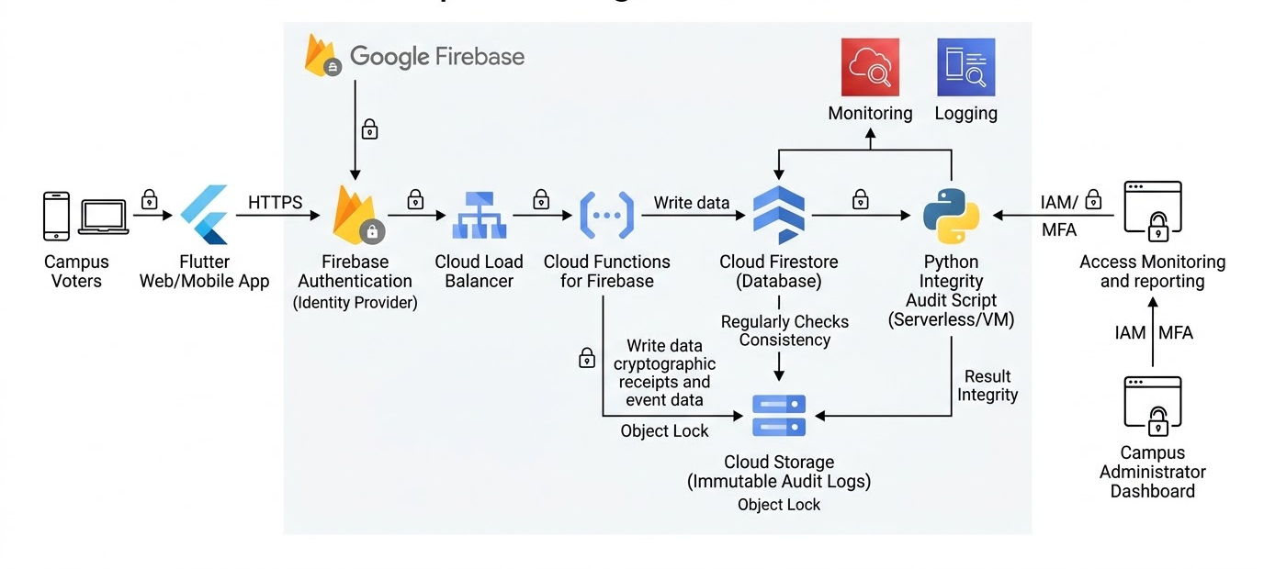
CSA15 | Cloud Computing and Big Data Analytics
Capstone Cloud Architecture
Our cloud architecture connects the user action to services
Individual student submission template | Department of Computer Science and Engineering
CO1 AT3 | 04
Notes:
Walk from user request to API, compute, data, storage, analytics, monitoring, and security boundary.

Slide 5
CSA15 | Cloud Computing and Big Data Analytics
Cloud Service Model Responsibility Matrix
Each service model defines what we control and what cloud manages
Service area
Model
Provider manages
Student team manages
Why this fits
PaaS
CDN, SSL, deployment infrastructure
Flutter code, UI/UX Routing
Enables fast, global delivery of the app with zero server maintenance.
Frontend hosting
FaaS
Runtime environment, auto-scaling, OS
Business Logic, vote processing, API endpoints
Scales automatically to handle traffic spikes during peak voting hours.
Backend/API
DBaaS
Replication, patching, backups, hardware
Data Schema Design, Security Rules, Logic
Real-time synchronization is critical for live-updating poll results.
Database
Object Storage
Durability, availability, bucket management
File Upload, Audit Log Organisation
Ensures durable, tamper-evident storage for immutable audit logs.
Storage
SaaS
Visualisation tools, log ingestion
Querying logs, setting performance alerts
Crucial for tracking system health during the live election.
Monitoring / logs
IDaaS
OAuth, platform security
User roles, access control rules, API Key
Offloads complex authentication to a secure, trusted provider.
Security / IAM
Individual student submission template | Department of Computer Science and Engineering
CO1 AT3 | 05
Notes:
Ask the student to defend provider responsibility and student responsibility for the selected service models.

Slide 6
CSA15 | Cloud Computing and Big Data Analytics
Data Flow and Analytics Pipeline
The product data moves from user activity to useful insight
Collect
Ingest
Store
Process
Visualize
Data Requirements
Analytics Requirement
Proof Required
Voter Identity: Auth events (Timestamp + UID).
Election Transactions: Vote payloads (VoterID + CandidateID).
Audit Trail: Immutable log files capturing every successful transaction.
Voter Identity: Auth events (Timestamp + UID).
Election Transactions: Vote payloads (VoterID + CandidateID).
Audit Trail: Immutable log files capturing every successful transaction.
Sample Input:
{"voter_id": "STU12345", "candidate_id": "CAND_01", "timestamp": "2026-07-17T11:00Z"}
Sample Output:
{"status": "Success", "current_tally": 542, "integrity_check": "Verified"}
Insight Generated: "System confirms 100% data consistency between user votes and audit logs."
Individual student submission template | Department of Computer Science and Engineering
CO1 AT3 | 06
Notes:
Big data analytics is optional, but a thoughtful data path is expected.

Slide 7
CSA15 | Cloud Computing and Big Data Analytics
Python / AI Module Integration
Python or AI adds intelligence where the product needs it
Python Role
Input and Output
Data validation & integrity verification. This script iterates through the Audit Log Files to ensure every vote corresponds to a valid user & no double voting has occurred
Input: JSON/CSV logs from Cloud Storage.
Output: A validation report (Boolean: “Integrity Verified” or “Anomoly Detected”).
Execution Point
Product Value
Scheduled Cloud Function (cron job) or on-demand triggered by an admin “verify” button.
Provides an automated, non-repudiable audit mechanism, ensuring voters that the result has not been tampered with
Individual student submission template | Department of Computer Science and Engineering
CO1 AT3 | 07
Notes:
If AI is not required, students can present a Python automation or analytics module instead.

Slide 8
CSA15 | Cloud Computing and Big Data Analytics
Security, Scalability, Privacy and Cost Design
Security, scale, privacy and cost shape the final design
Security
Privacy
Use Firebase Auth Service and IAM roles to restrict write access to the database. Use encryption at rest for the firestore database
Voter Identity(UID) is stored separately from the ballot choice in the database to ensure anonymity.
Scalability
Cost Awareness
The serverless nature of firebase handles thousands of concurrent requests without manual server management
Leveraging firebase “Spark” or “Blaze” Plan using free tier allowances for auth and firestore read/writes
Individual student submission template | Department of Computer Science and Engineering
CO1 AT3 | 08
Notes:
This slide is where students show engineering judgment instead of simply listing services.

Slide 9
CSA15 | Cloud Computing and Big Data Analytics
Implementation Stack and Deployment Evidence
Our implementation stack shows how the design will be built
Mobile / Web Layer
Cloud Services
Frontend Framework
Google Firebase
Evidence
Version Control
GUI Mockups
Using Git we will control the version
Individual student submission template | Department of Computer Science and Engineering
CO1 AT3 | 09
Notes:
Evidence should be specific and inspectable, not a generic list of tools.

Slide 10
CSA15 | Cloud Computing and Big Data Analytics
Demo Storyboard and User Journey
A complete user journey proves the product flow
Scene 1
Scene 2
Scene 3
Voter opens the Flutter app and signs in using Campus SSO (Firebase Auth).
Voter selects a candidate and taps "Cast Vote."
Cloud Function validates the request; writes vote to Firestore.
Scene 4
Scene 5
Scene 6
Cloud Function records the transaction in an immutable Audit Log file.
Admin dashboard triggers the Python integrity script.
Dashboard shows the final, verified results to users.
Individual student submission template | Department of Computer Science and Engineering
CO1 AT3 | 10
Notes:
A storyboard helps the faculty see whether the cloud architecture is connected to actual use.

Slide 11
CSA15 | Cloud Computing and Big Data Analytics
Evaluation Readiness Checklist
Our evidence confirms that the presentation is ready
Y
Cloud ecosystem and service model explained
Y
Elasticity and scalability decisions are visible
Y
REST/SOAP/API role connected to capstone
Y
GitHub and cloud evidence are inspectable
Y
Architecture has compute, data, storage, security, monitoring
Y
References and integrity statement are included
Evaluator Focus
CO1 is verified through cloud design reasoning, service choices, evidence, and individual explanation.
Individual student submission template | Department of Computer Science and Engineering
CO1 AT3 | 11
Notes:
Students can use this as the self-check slide before presenting the conclusion.

Slide 12
CSA15 | Cloud Computing and Big Data Analytics
Conclusion, Limitations and Future Scope
We close with learning, limitations and next steps
Learning Outcome
Limitations
What cloud concepts did the project make clear?
Current iteration relies on internet connectivity; future builds could include offline-first caching.
Future Improvement
Integrity Statement
Implement a Blockchain module to make Audit Logs truly immutable and verifiable by external third parties.
This project was built using Firebase/Flutter/Python. No external sensitive datasets were used.
Individual student submission template | Department of Computer Science and Engineering
CO1 AT3 | 12
Notes:
The ending should synthesize learning, not just say thank you.

